Slide 1
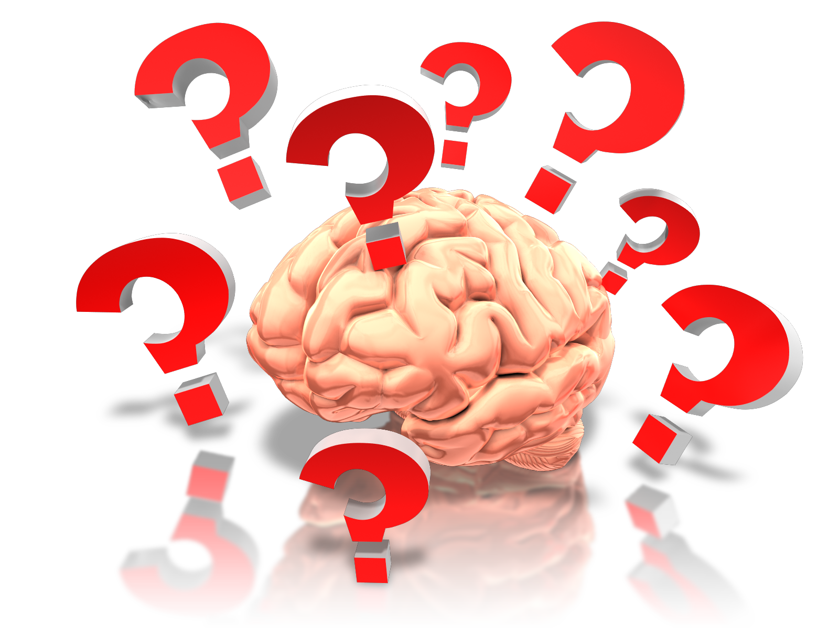
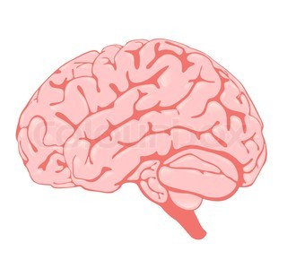
How does your brain work?

Slide 2
Which one are you?
Or a
?
Fixed
Mindset
Mindset

Slide 7
Quick Quiz
Given a really difficult maths question. (p58)
Not very good at a sport in PE. (p86)
Top of the class at English in Yr4, but struggling with spelling in Yr7.
A really good sports player who loses a match.

